Slide 1
Voting Application
By: Jack O’Rear

Slide 2
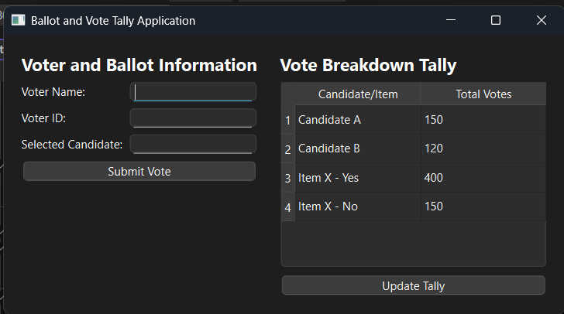
Description
This project is a voting application
It will take a voter’s name, voter ID, and their choice of candidate.
Once all votes have been entered, the “Update Tally” button may be pressed to update the tally of scores. The candidate with the most votes is the winner.

Slide 3
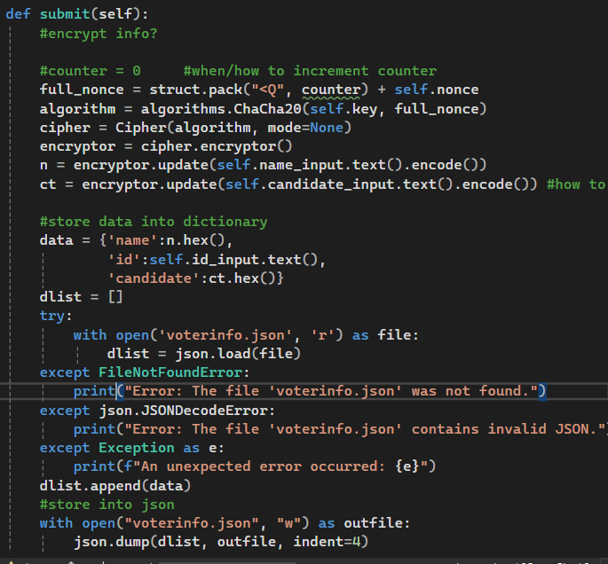
Submit function
Both name and candidate are encrypted using the ChaCha20 stream cipher, which is an example of symmetric encryption
The program then stores the data in a dictionary, appends it to the list of dictionaries, and writes the list to a json file.

Slide 4
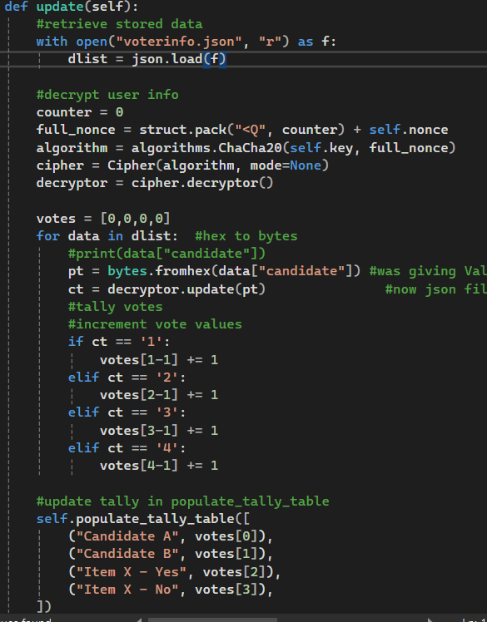
Update function
List of dictionaries is read from json file
Voter info is decrypted
Tally of votes per candidate/item is made, and the tally table is updated

Slide 5
Future Additions
Add the ability to vote in multiple races/on multiple items at once.
Make it so text fields are cleared when “Submit Vote” button is clicked.

